Slide 1

Sambandh Bhusan Dhal UIN: 726006080
WSAR: Complete Coverage Algorithm (CC) with search space division

Slide 2
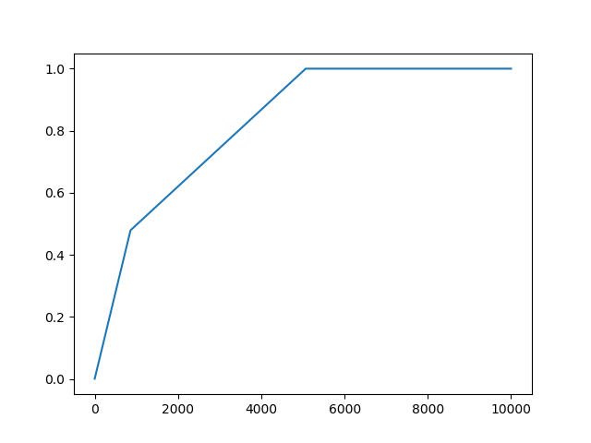
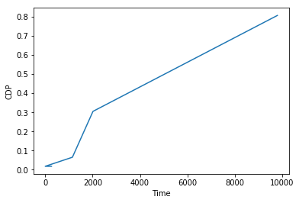
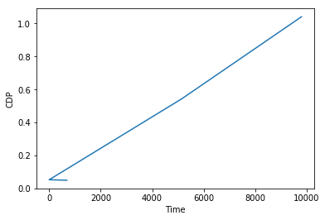
CDP Vs Time Performance:
NOTE: The first graph is for my proposed algorithm with heatmap 1 as input
The second graph is for my proposed algorithm with heatmap 2 as input
The third graph is for the base algorithm with heatmap 1

Slide 3
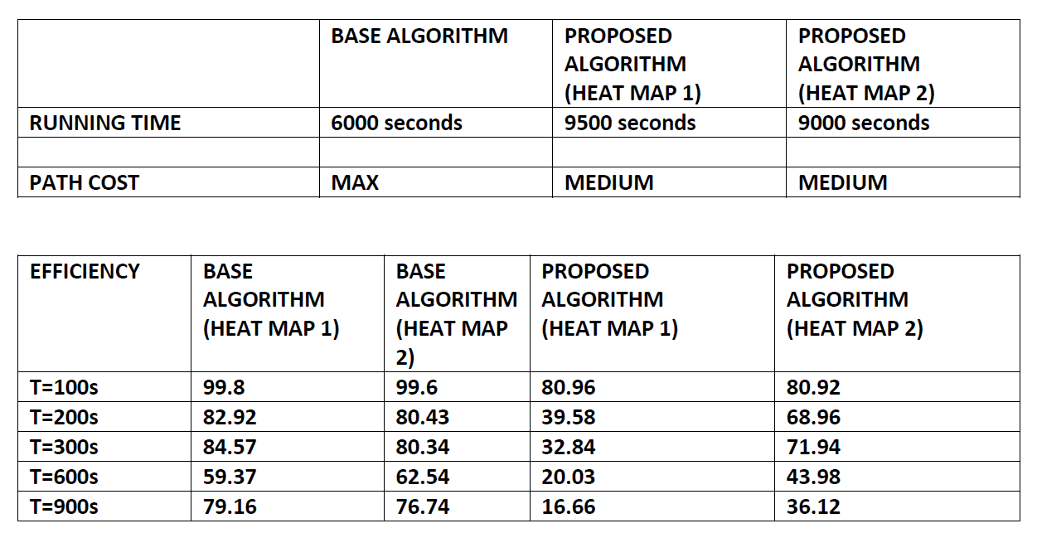
EFFICIENCY VS TIME PERFORMANCE:

Slide 4
Discussion of the algorithm:
Divides the search space in to 4 halves and searches each independently
Poor performance in comparison to base algorithm in terms of time taken for the graph to converge
Space complexity is greatly improved
The search path to identify points with high probability must be improved upon

